Slide 1

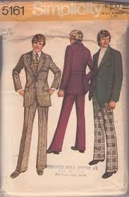


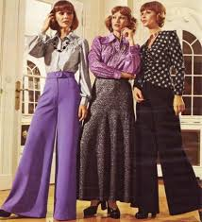




Healthy Mind Vintage network
Date: Wed 24 Sep 2014 (Heritage Day)
Time: 1pm – 7pm
Venue: Emthonjeni Country Club
26 Willow rd, BlueHills Midrand
Dress Code: Fancy Vintage look
!!!Cash Bar!!! Exclusive Wine Range
Fee: R160 pp (limited seats) Snacks will be served
Reservations close on 21 Sep
Pre-Booking Sandi: 082 547 0010/WhatsApp; BBM 2B790FB5
Thandeka 073 043 7880
Bank details www.point2pointconnections.yolasite.com/upcoming-events.php
Fun & informative gathering
Make an everlasting impression & win a prize!!!
Get to know someone who knows someone!
Brought to you By
& Emthonjeni Events

Slide 2
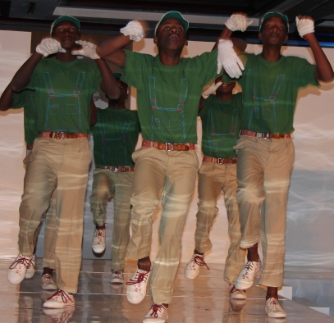







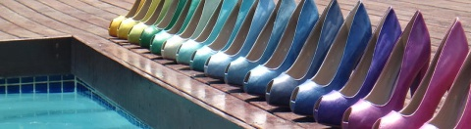



Brought to You By
& Emthonjeni Events
Place your order on any of the Products on the day & get a discount
This event is aimed at young at heart entrepreneurs & individuals who are willing to share their steps through their success journey & to learn from others.
If you are willing to participate as a speaker or to market your business on our future events please email sandi.maqoqa@gmail.com for more details. Seats & tables are limited.
Book your seat now to avoid disappointment. This invite is open to anyone who aspires to share or gain business related info & fun loving.
Do you have a topic to share with the audience? Do you have a product to demonstrate/promote? Are you launching a new business ? Do you want to learn from other people’s journey to success?...Contact us for our next theme.
www.Point2Pointconnections.yolasite.com

Slide 3


!!For the Love of the Spring Season!!
ADDRESS & DIRECTIONS:
From JHB/Pta: Take N1 North/South to Midrand, off-ramp @Olifantsfontein rd, @Robots turn left ...proceed & cross the next big intersection towards Diepsloot. Pass Savanna Hills residential complex on your right until you see Sasol Garage on your right at next intersection. Cross over the robots (R55 intersection) and take immediate left gravel rd (Willow rd). The venue is the 1st gate on your left.

